Slide 1



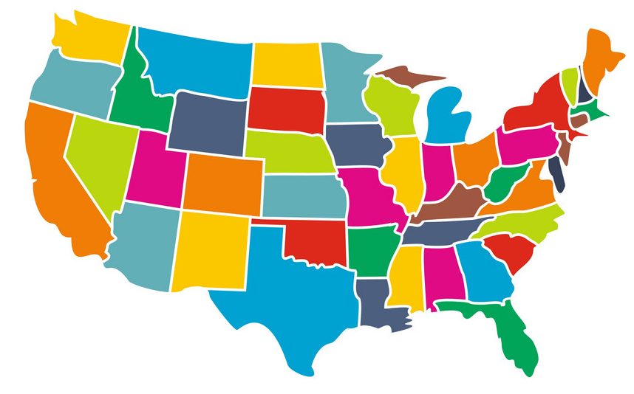
- David Gill Data 606
PREDICTING SALES FOR MULTIPLE WAL-MART STORES
Delivery 3: EDA and Implementing ML Algorithms

Slide 2
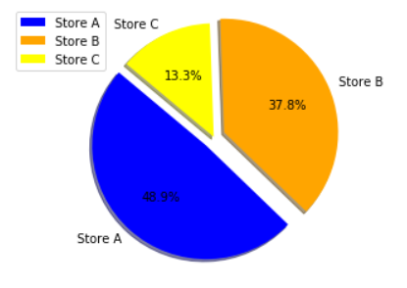
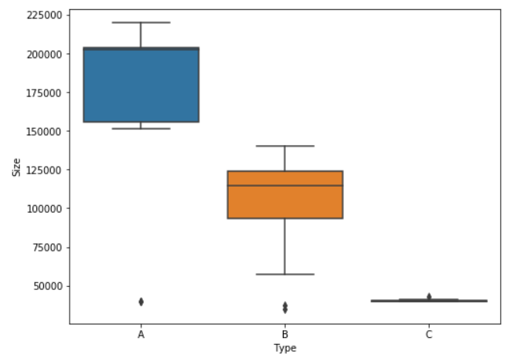
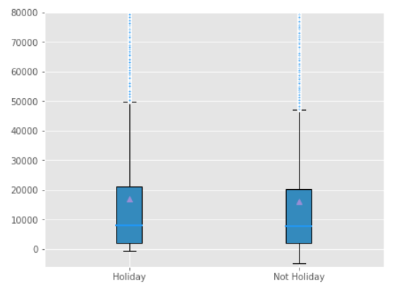
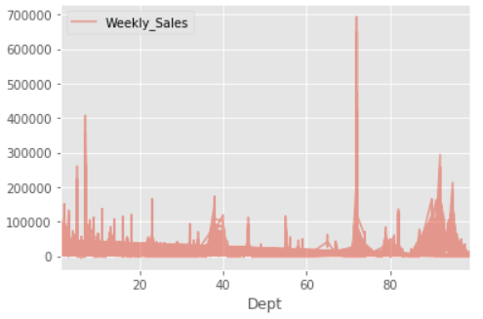
Brief Recap

Slide 3
SIMILAR RESEARCHES
Electronic Devices Sales Prediction Using Social Media Sentiment Analysis
Brief Recap
Predicting sales in a food store department using machine learning
Drugs store sales forecast using Machine Learning

Slide 4
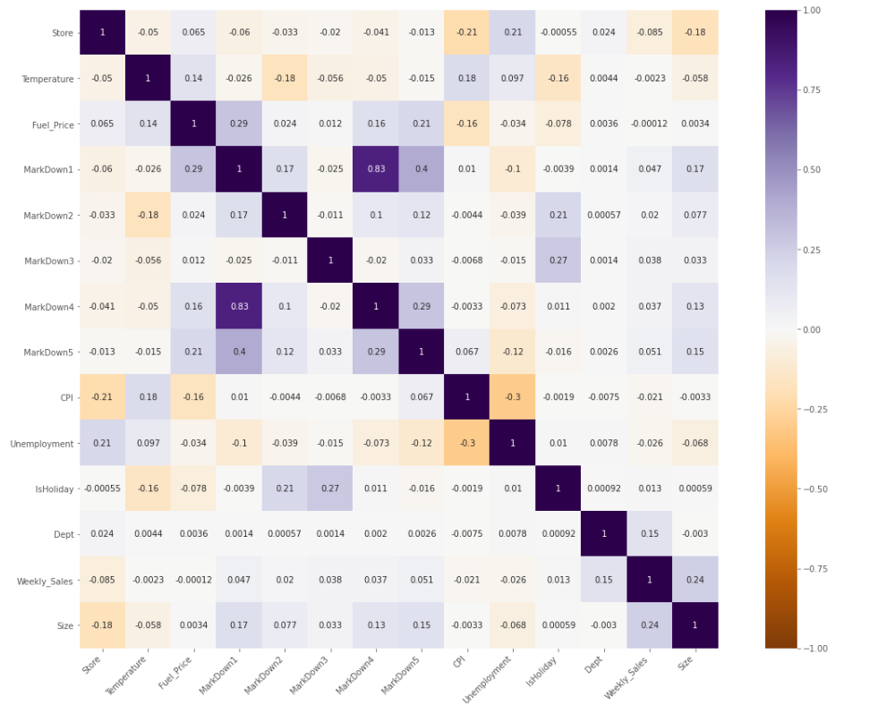
Correlation Matrix

Slide 5
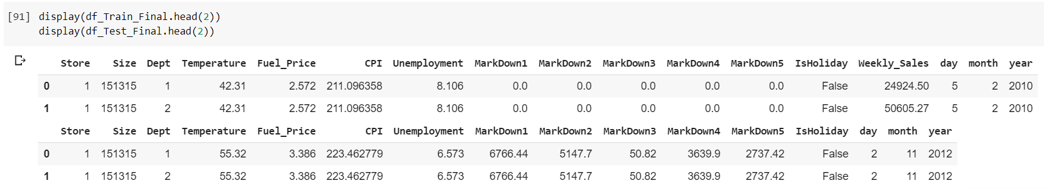
PREPARING TRAINING AND TESTING DATA-SET
- Total of 15 attributes to train the model
Store | Size | Dept
Temperature | Fuel_Price | CPI
Unemployment | MarkDown1 | MarkDown2
MarkDown3 | MarkDown4 | MarkDown5
IsHoliday | Date (split into day, month and year) | Weekly_Sales
Train Dataset
Test Dataset

Slide 6
MODELS USED
K- Nearest Neighbor:
Robust
- Implementation is simple
- Useful in regression and classification problems
Random Forest:
Uses ensemble method
Handles missing values
Higher accuracy
Extra Trees:
- Equally robust as Random Forest
- Quicker than Random Forest
VALIDATION METRICS USED
RMSE: Root Mean Square Error
MAE: Mean Absolute Error

Slide 7
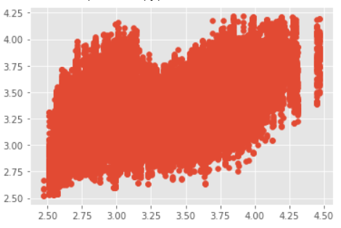
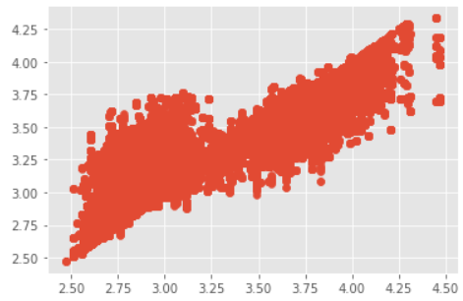
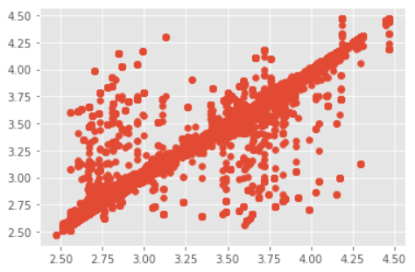
MODEL COMPARISON
← K- Nearest Neighbor
MODEL | ROOT Mean square error | Mean absolute error | Accuracy
KNN | 39.81 | 32.85 | 43.25
Random Forest | 22.31 | 14.03 | 76.55
Extra Trees | 10.1 | 1.5 | 98.81
Random Forest →
← Extra Trees

Slide 8


Questions/ Feedback
Email: agill2@umbc.edu
Github: https://github.com/DavidGill606/Data606

